Slide 1
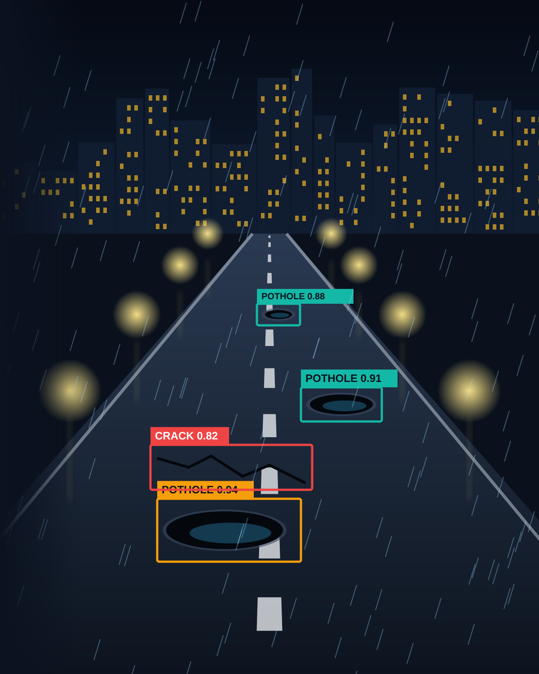
CiviTwin AI
AI-Powered Flood Preparedness Planner for Local Roads and Drains
Prepare streets for heavy rain before it arrives.
Track: IC26-05-04 ClimateReady: Local Heat and Flood Preparedness Planner (Software)
Bharath Reddy Gummana
P. Sharmila
Y. Muni Jagan
Department of Civil Engineering
KSRM College of Engineering, Kadapa.
AI
Climate Resilience
GIS
Flood Preparedness
Notes:
Open with the hook: road problems become public problems because we find them late. CiviTwin AI flips that - we predict and prioritize. Introduce yourself and the one-line idea. Keep this slide under 30 seconds.

Slide 2
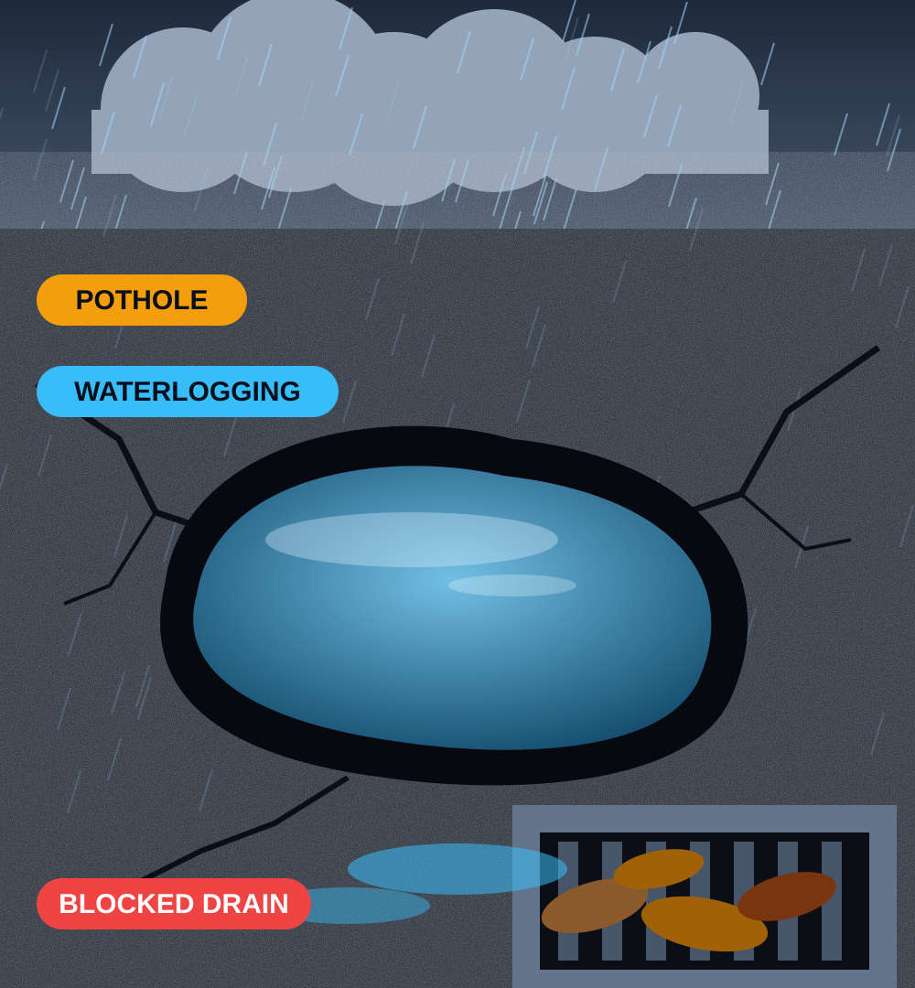





The Challenge: Roads Unprepared for Heavy Rain
Heavy rain turns damaged, poorly drained roads into flood points
Drain blockages are found after flooding, not before
Road damage, drainage and rainfall are assessed separately
Low-lying areas and critical sites get no extra priority
Local bodies lack a simple pre-monsoon action list
The need: a local planning tool that links road condition, drainage and rainfall to a ranked flood-preparedness plan.
Notes:
Explain the pain: inspections are manual, damage is found after complaints, and drainage and road condition are looked at in separate silos. Land the closing banner: we need one integrated, prioritized view.

Slide 3
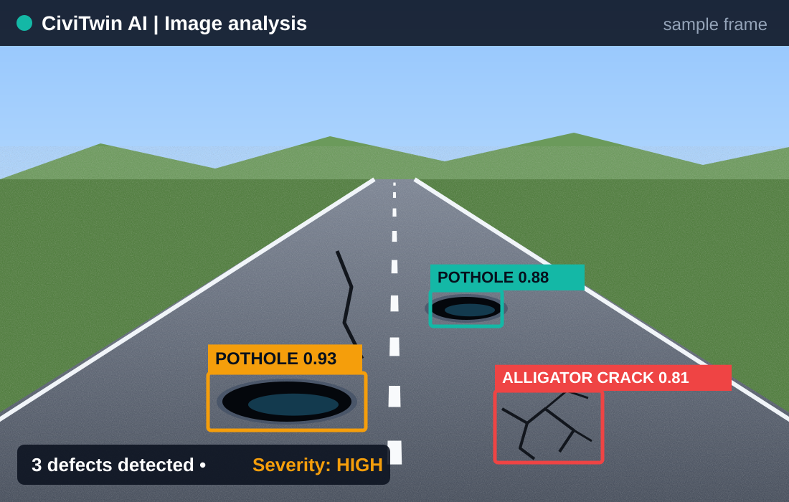




Introducing CiviTwin AI
A software decision-support tool for local flood preparedness, combining computer vision, rainfall and drainage risk analysis, vulnerability inputs and action planning.
Pothole and crack screening from images
Rainfall and drainage-based waterlogging screening
Segment risk score with a vulnerability factor
GIS-style map of flood-prone roads
Preparedness action list and downloadable reports
Illustrative output: AI-assisted detection of potholes and cracks
Expected outcome: drains cleared, roads repaired and warnings issued where they matter most, before heavy rain.
Notes:
This is the hero slide. The picture shows what the detection step produces. Walk through the five features quickly - image detection, rainfall and drainage screening, segment scoring, GIS-style view, automated reports.

Slide 4


Objectives and Novelty
Project Objectives
What makes it innovative?
Identify road defects that worsen water accumulation
1
Road condition, drainage and vulnerability in one workflow
Estimate waterlogging risk from rainfall and drainage inputs
2
Image analysis combined with environmental and infrastructure inputs
Account for vulnerability: low-lying zones and critical facilities
Explains why a segment gets its priority
3
Recommends actions, not only a score
Generate an explainable risk score per road segment
4
Novelty: flood risk, community vulnerability and recommended actions in one explainable platform.
Produce prioritized preparedness actions
5
Notes:
Left: what we set out to do. Right: why it is different. Stress the word 'explainable' - every priority score comes with the reasons behind it, which is what makes it trustworthy to engineers.

Slide 5



Technology Approach and Architecture
Input Data
Image Processing and Risk Analysis
Risk Scoring Engine
GIS-Style Dashboard
Preparedness Action Plan
Technology Stack
Inputs
Programming
Python
Road photographs
Rainfall intensity
Drainage blockage condition
Road importance and vulnerability
Web app
Streamlit
Computer vision
OpenCV + pretrained road-damage model
Risk analysis
Weighted scoring rules
Outputs
Visualization
Plotly
Detected or verified defects
Waterlogging risk indicator
Road-segment priority score
Suggested preparedness actions
Mapping
Folium or schematic road network
Data
CSV or SQLite
Notes:
Read the architecture left to right: data comes in, we analyze images and environment together, a scoring engine turns that into a number, the dashboard shows it, and the report is what the inspection team takes into the field. Everything uses free, accessible Python tools.

Slide 6

How CiviTwin AI Works
1
2
3
4
5
6
Upload a road photograph
Analyze image for visible damage
Enter rainfall and drainage condition
Tag vulnerability and road importance
Calculate flood risk and priority
Recommend actions and export report
ILLUSTRATIVE RISK-SCORING FORMULA
Weight of each factor in R
R = 0.30W + 0.25B + 0.20D + 0.15V + 0.10I
W
Waterlogging risk
B
Drainage blockage severity
D
Road damage severity
V
Vulnerability (low-lying, critical sites)
I
Road importance
Weights are demonstration assumptions. Calibrate and validate with field data before deployment.
Each input is normalized to a score between 0 and 100.
Notes:
Walk the six steps, then the formula. Be upfront: the weights are starting assumptions for the demo, not certified engineering values - they need calibration with field data. That honesty is a strength with judges.

Slide 7
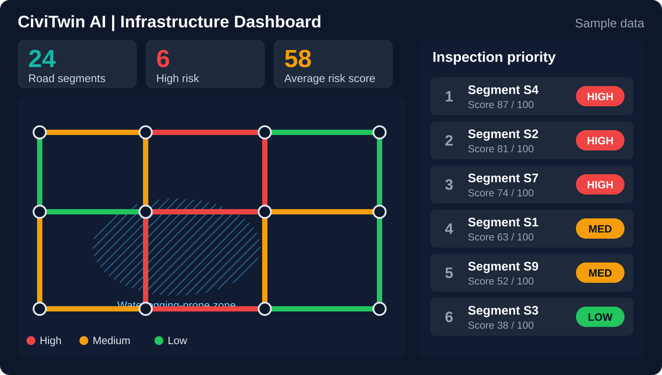
Proposed Software Prototype
1 Road Inspection
Upload images, view detections, record segment details
2 Risk Assessment
Enter rainfall, drainage and vulnerability; get an explained score
3 Flood Risk Dashboard
Sample segments, risk indicators, ranked readiness table
4 Preparedness Plan
LIVE DEMO FLOW
Ranked actions by urgency, exported with risk factors to CSV
Upload image
Enter conditions
Calculate risk
Plan actions
Export report
Notes:
The screenshot is a mock-up of the dashboard with sample data. Four modules cover the whole story. If you demo live: upload an image, enter rainfall and drainage values, calculate, show the ranked list, export the CSV - about two minutes.

Slide 8



Feasibility, Viability and Impact
Technical Feasibility
Economic Viability
Expected Impact
Open-source Python libraries
No sensors or special hardware
Works with sample images and manual inputs
Basic prototype in 1 to 2 days with limited scope
Prototype built with free tools
No dedicated hardware for the demo
Future costs: hosting, data, model upkeep
Users: municipalities, road agencies, consultants
Earlier identification of likely flood points
Targeted pre-monsoon drain and road work
Better protection for schools, hospitals and low-lying areas
Records for resilience planning; heat layer as a future add-on
Limitations and risk mitigation
AI detections require human verification
Risk scores are not certified engineering assessments
Field validation is needed before real-world use
Notes:
Show it is realistic: free tools, no hardware, buildable in a couple of days. Then be candid about limits - detections need human verification and scores are screening-level, not certified. Judges respect that.

Slide 9

References Taken
Arya, D., et al. (2022). RDD2022: A multi-national image dataset for automatic Road Damage Detection.
https://github.com/sekilab/RoadDamageDetector
1
NASA Global Precipitation Measurement (GPM). Precipitation data and resources.
https://gpm.nasa.gov/data/directory
2
Resources behind the approach
Streamlit. Official documentation for building interactive Python applications.
https://docs.streamlit.io/
3
Any dataset, model or methodology used in the final prototype will be cited accurately.
OpenCV. Official computer vision library documentation.
https://docs.opencv.org/
4
Folium. Python library for interactive Leaflet maps.
https://python-visualization.github.io/folium/
5
Notes:
Keep this brief. Mention RDD2022 as the road-damage dataset the approach builds on and the NASA GPM data as the rainfall source option.

Slide 10

THANK YOU
CiviTwin AI
Flood-Ready Streets. Safer Communities. Data-Driven Resilience.
Questions and Discussion
Bharath Reddy Gummana
P. Sharmila
Y. Muni Jagan
Department of Civil Engineering, KSRM College of Engineering, Kadapa
Predict
Prepare
Protect
Notes:
Close on the three verbs: Predict, Prioritize, Maintain. Thank the judges and invite questions.

